Slide 1



Population Coding of Lightness
In
Primate Visual Cortex
David H. Brainard, Douglas A. Ruff, & Marlene R. Cohen

Slide 2
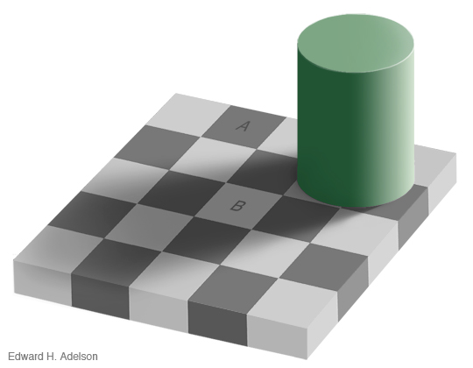
Lightness is not luminance
Checks A and B have the same luminance but different perceived lightness
http://web.mit.edu/persci/people/adelson/checkershadow_illusion.html

Slide 3
Lightness is not luminance
Checks A and B have the same luminance but different perceived lightness
http://web.mit.edu/persci/people/adelson/checkershadow_illusion.html

Slide 4
Such effects support perception of intrinsic object properties
Luminance reaching eye is illumination irradiance times surface reflectance.

Slide 5
Such effects support perception of intrinsic object properties
The same luminance reaches the eye from A and B, but illumination is perceived to be different

Slide 6
Such effects support perception of intrinsic object properties
Lightness appears to be correlated with surface reflectance

Slide 7
Is this explained by local contrast coding?
d

Slide 8
Is this explained by local contrast?
d

Slide 9
Lightness is not explained entirely by local contrast coding
After Gilchrist, 2006; Gilchrist & Radonjić, 2010

Slide 10
Lightness is not explained entirely by local contrast coding
After Gilchrist, 2006; Gilchrist & Radonjić, 2010

Slide 11
Outline for today
Describe psychophysical experiment that quantifies a contextual lightness effect.
Measure multiunit responses in monkey visual cortex to the same stimuli, using implanted multi-electrode arrays.
Build a decoder that predicts stimulus luminance from multiunit responses.
Link the decodings to the psychophysical effects.

Slide 12


Simplify stimuli to ‘paint’ versus ‘shadow’ checkerboards
Paint Checkerboard
Shadow Checkerboard
Probe disks placed at center of 5 by 5 checkerboards.
Each of the 25 corresponding checks has same average luminance in
the paint and shadow checkerboards.
Probe disks have same local contrast as well as luminance matched broader
context.
After Hillis & Brainard, 2007

Slide 13
Quantify the perceptual lightness effect for these stimuli
Observer fixates center of LCD display.
On each trial, two checkerboards with instered disks presented side by side.
Checkerboards are 3.5° by 3.5° and centered at +/- 3.5°.
Observer indicates which checkerboard contains the lighter disk.
Paint/shadow trials intermixed with paint/paint control trials.
Staircase procedure adjusts disk intensities.

Slide 14
Let’s try some trials

Slide 15
Let’s try some trials

Slide 16
Let’s try some trials

Slide 17
Basic Psychophysical Data
Reference Disk in Paint
Reference Luminance 0.5

Slide 18
Point of Subjective Equality (PSE)
Reference Disk in Paint
Reference Luminance 0.5

Slide 19
Representing One PSE

Slide 20
Data obtained for multiple reference disks placed in both paint and shadow

Slide 21
Paint/Shadow Effect, One Subject

Slide 22
Psychophysics Summary

Slide 23
Psychophysics Summary

Slide 24
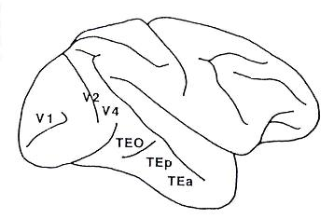
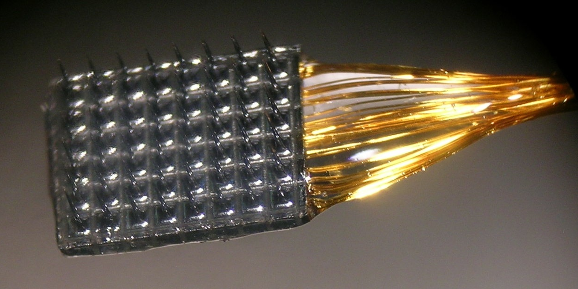
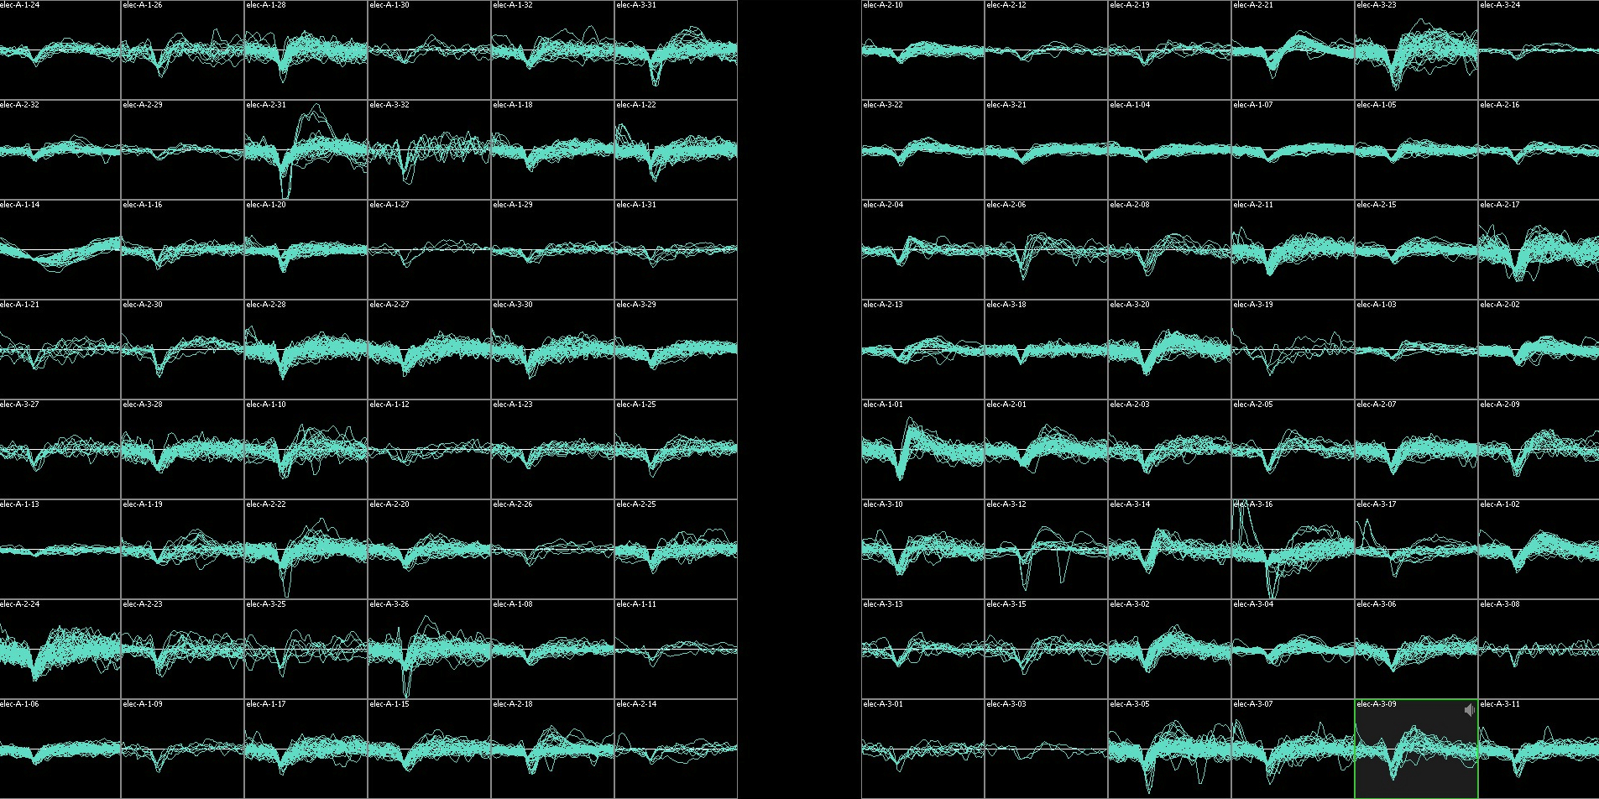
Chronic array recordings
Chronic array recordings
1 mm
Notes:
24
While the monkeys performed that task, we recorded from cortex with chronic array recordings. we implanted two small utah arrays like the one shown here into cortex.
For this project, we placed one array in V4 in both hemispheres of one monkey. V4 is a mid level visual area in the ventral processing stream where previous work has demonstrated that both the rates and correlation structure of neurons is modulated by attention.
Here im showing example RFs centers from the two arrays from a previous study

Slide 25
Physiology methods (V4)
Bilateral V4 arrays (6 by 8 electrodes each). One monkey.
Monkey performs fixation task while a single checkerboard is presented on each trial.
Both paint and shadow checkerboards presented, with disk luminances between 0.0 and 1.0 (re display max). Only increments (0.2 – 1.0) analyzed here.
A variety of checkerboard sizes (1.5°-27°, mean 9.5°, median 9°) and center locations (0.5°-4.5°, mean 1.5°, median 1.5°) were tested; generally the checkerboards were centered on RFs covered by electrode arrays.
Manual spike sorting.

Slide 26
Sample single channel data, V4, monkey JD
13° checkerboard
1.25° eccentric

Slide 27
Sample single channel data, V4, monkey JD

Slide 28
Analysis: build a decoder for stimulus luminance/contrast
Probe luminances for M trials
(typically 100s of trials)
Use regression to find weights that best predicts probe luminances from multiunit responses.
Decoding weights are found using both paint and shadow trials (biases decoder towards predicting same luminance for each type of checkerboard).
Leave-one-out method used: find decoding weights for M-1 trials and predict the left out luminance with those weights.
Regression finds weights
N multiunit responses for each
trial (~90 multiunits)

Slide 29
Example decoding (V4)

Slide 30
From decoding to predicting psychophysical PSEs

Slide 31
From decoding to predicting psychophysical PSEs

Slide 32
V4 decodings show paint/shadow effect similar to psychophysics
V4
Psychophysics
Decoded ranges > 0.2
Session (nominal)

Slide 33
How many units do you need to decode well?
Decoded ranges

Slide 34
How many units do you need to decode well?
FIX Y AXIS LABEL – NOW FIXED IN CODE JUST
NEED TO GRAB THIS AND OTHER CORRESPONDING
FIGS FOR PRESENTATION.
Decoded ranges

Slide 35
How many units do you need to decode well?

Slide 36
How many units do you need to decode well?

Slide 37
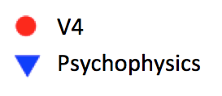
How many units do you need to decode?
Session (nominal)

Slide 38
Do “noise correlations” matter?
Session (nominal)

Slide 39
Physiology methods (V1)
Unilateral V1 array (10 by 10 electrodes). Two monkeys.
Monkeys perform fixation task while a single checkerboard is presented on each trial.
Both paint and shadow checkerboards presented, with disk luminances between 0.0 and 1.0 (re display max). Only increments (0.2 – 1.0) analyzed here.
A variety of checkerboard sizes (4.5°-13°, mean 10.8°, median 11.0°) and center locations (2.0°-8.5°, mean 3.3°, median 3.1°) were tested; generally the checkerboards were centered on RFs covered by electrode arrays.
Manual spike sorting.

Slide 40
Example decoding (V1)

Slide 41

V1 decodings do not show paint/shadow effect
V4, JD
V1, BR
V1, ST
Psychophysics
Decoded ranges > 0.2
Session (nominal)

Slide 42
Summary/Discussion
Population decoding does a reasonable job of predicting stimulus luminance from V1/V4 responses.
V4 decoding across paint and shadow checkerboards is consistent with lightness psychophysics, while V1 decoding is not. This difference may reflect different stimulus size/rf size ratios, or different RF coverage of the stimulus in V1 an V4.
Some things we are thinking about:
• Relation between decoding and underlying
unit RF sizes and RF locations, relative to the
stimulus.
• What single unit properties drive the
decoding and the observed paint/shadow
effects in the decodings?
• To what degree can we classify paint
versus shadow trials in V1 and V4?
• Would something very different happen if
we used a non-linear decoder?

Slide 44
Individual unit contributions to decoding

Slide 45
Checkerboard size and eccentricity

Slide 46
Sample single channel data, V4, monkey JD
13° checkerboard
1.25° eccentric

Slide 47
Sample single channel data, V4, monkey JD

Slide 48
Sample single channel data, V4, monkey JD

Slide 49
Decoded ranges provides one summary of decoding quality
Decoded ranges

Slide 50
How many units do you need to decode?
Session (nominal)

Slide 51
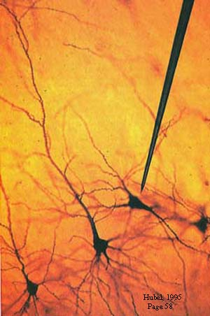
Studying the neural basis of perception

Slide 52
Chronic array recordings
Receptive field centers
Elevation
1 mm
Azimuth
6x8 grid of electrodes in each hemisphere of V4
400 microns between adjacent electrodes

Slide 53
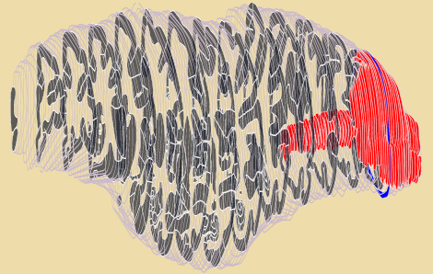
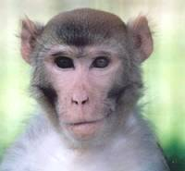
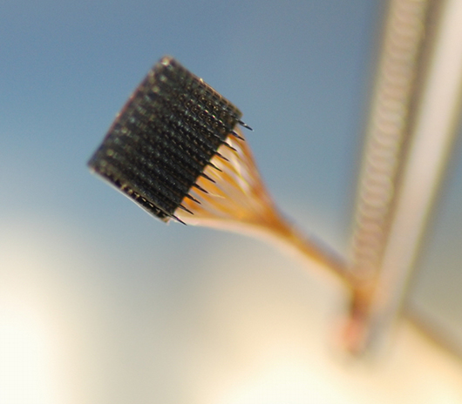

Slide 54
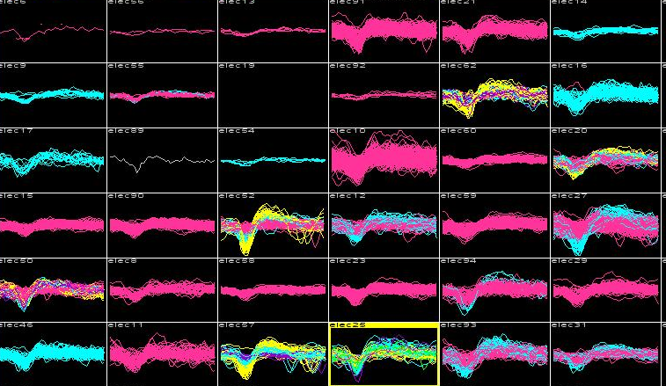

Slide 55
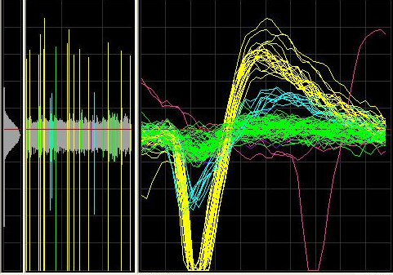

Slide 56
Reminder: Contrast can have a large effect on lightness

Slide 57
Reminder: Contrast can have a large effect on lightness

